Slide 1
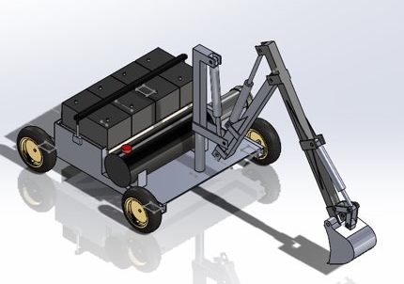
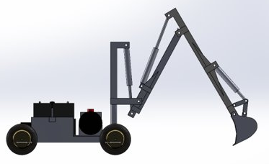
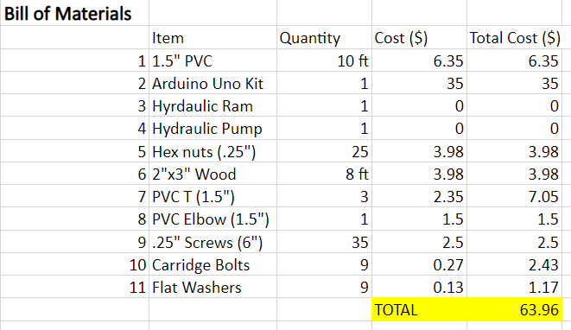
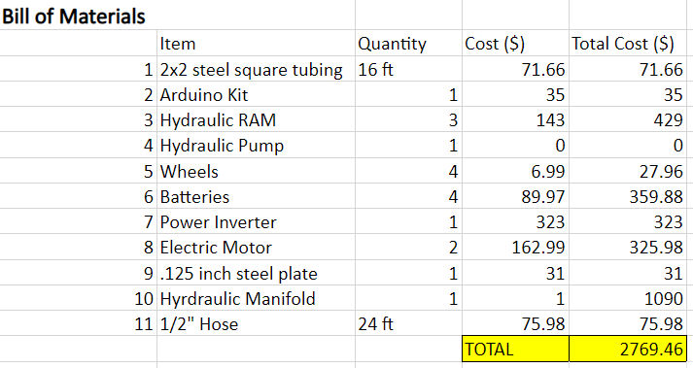
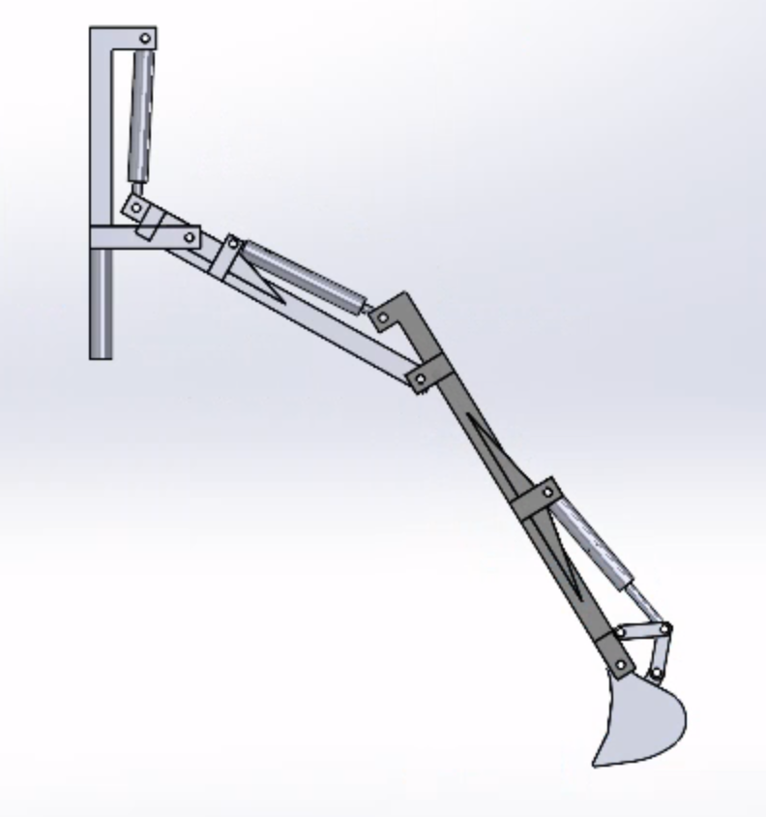
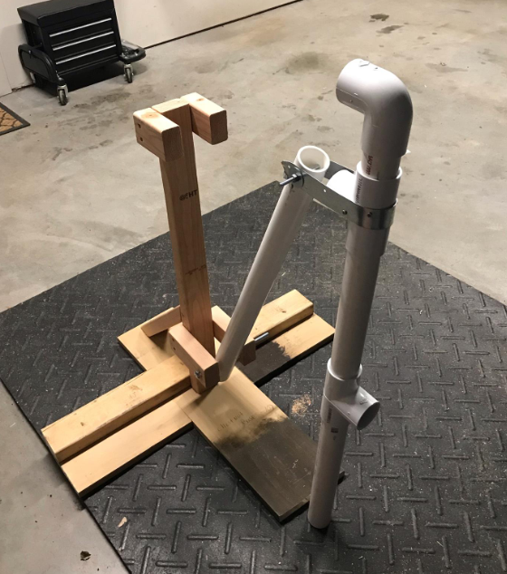
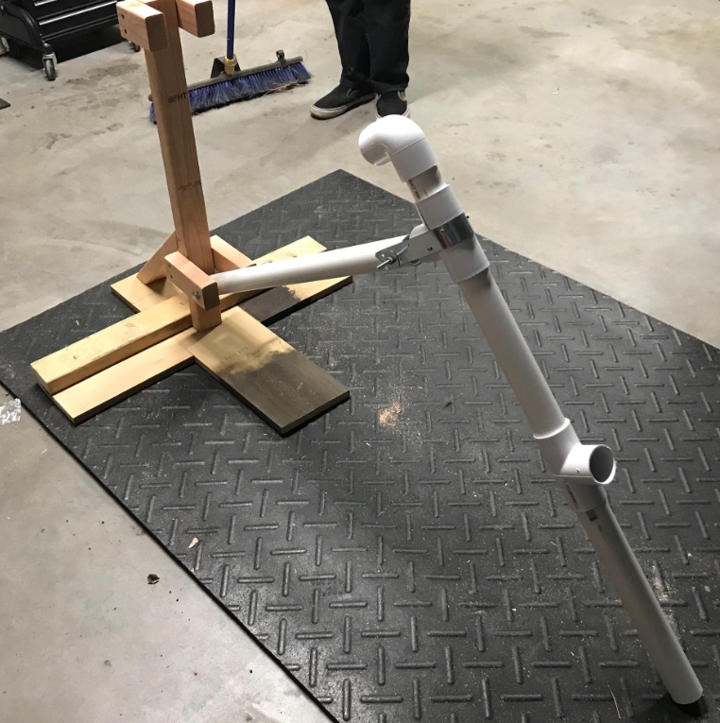
Remote Operated Excavator
Alec Boyce, Ryan Fortier, Davis Geniza, Oscar Nunez, Zhiyu Wang
Department of Mechanical Engineering, Northern Arizona University, Flagstaff, AZ 86011
Abstract
Excavator Design
Conclusion
The team's original objective was to create an electrically powered, remote operated, garden-sized excavator. The excavator must be able to dig an irrigation trench 1' in depth, 6'' in width, and approximately 5' in length. The excavator designed is roughly 40'' in length and 30'' wide, with a hydraulically powered arm, and electric motors controlling the wheels and swivel. An Arduino Uno microcontroller is designed to remotely operate the excavator via Bluetooth and an Android device. Due to COVID related delays, the team's objective was altered to creating a proof of concept of the excavator's arm and controlling the hydraulic system with Arduino.
The client’s requirement of a remote operated, electric powered, excavator suitable for digging garden-sized irrigation ditches, is the primary goal of the team’s design. To begin the design process, customer requirements were specified, clarified and prioritized, allowing the team to then create quantifiable engineering requirements using a QFD. The team then ran tests that included investigating operability of the ECU, hydraulic system, and power supply, while also using FEA to theoretically test stress and strain values of the frame and arm of the excavator.
The excavator uses Arduino to remotely operate the excavator. The hydraulic system, powered by the lead acid batteries, will allow an operator to remotely dig an irrigation trench, approximately 1 foot deep and 6 inches wide. The arm of the excavator was designed to swivel 90 degrees in either direction to allow the excavator to dump the dirt without moving the entire excavator. The current design is expected to meet all requirements presented by our client. Although, due to delays and budget shortages induced by the pandemic, the team's design could not be built to completion. Instead, prototyping the arm and controlling the hydraulic system with Arduino became the team's end objective.
Figure 1: Isometric view of the final design
Figure 2: Side view of the final design
Results
Requirements
References
Figure 3: Final Bill of Materials
Figure 4: Original Bill of Materials
[1]“CONTACT REMOQUIP,” Remoquip. [Online]. Available: https://remoquip.com/. [Accessed: 15-Sep-2020].
[2]"Harbor Freight Tools – Quality Tools at Discount Prices Since 1977", Harborfreight.com, 2020. [Online]. Available: https://www.harborfreight.com. [Accessed: 08- Sep- 2020].
[3]Longdom.org, 2020. [Online]. Available: https://www.longdom.org/open-access/study-of-forces-acting-on-excavator-bucket-while-digging-2168-9873-1000282.pdf.
Excavator must be completely electric powered.
The excavator must be remotely operated.
Dig a 1' by 6" trench.
Operate for a full work-day (8 hours).
Durability to withstand wear and tear.
Maneuverability due to projected working area (residential).
Following Objective Change
Create arm proof of concept, displaying kinematic ability of design.
Operate hydraulic system with Arduino controlled solenoid valve.
The final bill of materials was much lower than the original , as the requirements changed from building the entire design to creating system prototypes (Figure 3 & 4).
The maximum achievable depth of the arm is 36 inches from the pivotal point of the boom. The pivotal point of the boom is 12 inches above the ground which increases the necessary depth of reach to be 24 inches, which is still below the achievable depth of 36 inches (Figure 4). The proof of concept of this design was created with wood and PVC piping (Figure 5).
Acknowledgements
Figure 6: Proof of concept of the designed arm
Dr. David Trevas
Dr. Sarah Oman
Department of Engineering, Northern Arizona University
Figure 5: Excavator Arm design extended

